Slide 1


PROJECT PRESENTATION
Adaptive Quiz and Exam Engine
Presented by
P. V. Srisukta Hiranmayi - 2620030019
Ch. Akshitha Satwika - 2620030014

Slide 2


Abstract
The Adaptive Quiz and Exam Engine is designed to conduct subject-wise quizzes and adjust question difficulty according to a user's performance. The application collects the user's name and roll number, allows the user to select a subject, presents questions at a selected difficulty level, accepts answers, and calculates the final score by comparing responses with predefined answer keys. Based on the score, the engine increases, decreases, or maintains the difficulty level for the next quiz, providing a simple form of personalized assessment.
The program uses core Java concepts such as variables, conditional statements, switch statements, loops, arrays, and user-defined methods to organize quiz logic. Object-oriented programming is applied through a QuizResult class with encapsulated fields, a constructor, and methods for representing and accessing result data. File handling supports saving quiz results and reading previous results, while exception handling helps manage file input/output errors. The Collections Framework and Stream API are used to manage results, filter passing scores, and display a leaderboard. By combining adaptive difficulty, result storage, and basic performance summaries, the project demonstrates how Java programming concepts can be integrated into a practical educational application.

Slide 3





Understanding Problem Statement
Traditional exams give every student the same fixed questions, whatever their ability.
Manual checking and result preparation is slow and open to errors.
Learners need quizzes whose difficulty adapts to how they perform.
Our Java engine adapts questions, scores answers and saves results to files.

Slide 4


CO1
Programming Fundamentals
Variables
1
Data types
2
Constants and literals
3
Operators
4
CO1
Scanner class
5

Slide 5


CO2
Control Statements
1
Conditional statements (if-else)
2
Nested if
3
switch
4
Loops (for, do-while)
break
CO2
5
6
continue

Slide 6


CO3
Methods and Arrays
Methods
1
One-dimensional arrays
2
Summation
CO3
3

Slide 7


CO4
OOP, Strings and Sorting
Classes and objects
1
Constructor
2
OOPs (Encapsulation)
3
Strings
4
CO4
Sorting and Comparator interface
5

Slide 8

CO5
Strings, Files and Exceptions
1
String handling
6
File appending and line-by-line reading
2
File handling
7
Exception handling (try-catch)
3
FileWriter
8
IOException
4
FileReader
9
Try-with-resources
CO5
5
BufferedReader

Slide 9


CO6
Collections and Streams
Collections (ArrayList)
1
Generics
2
Stream API
3
CO6
Lambda expressions
4

Slide 10

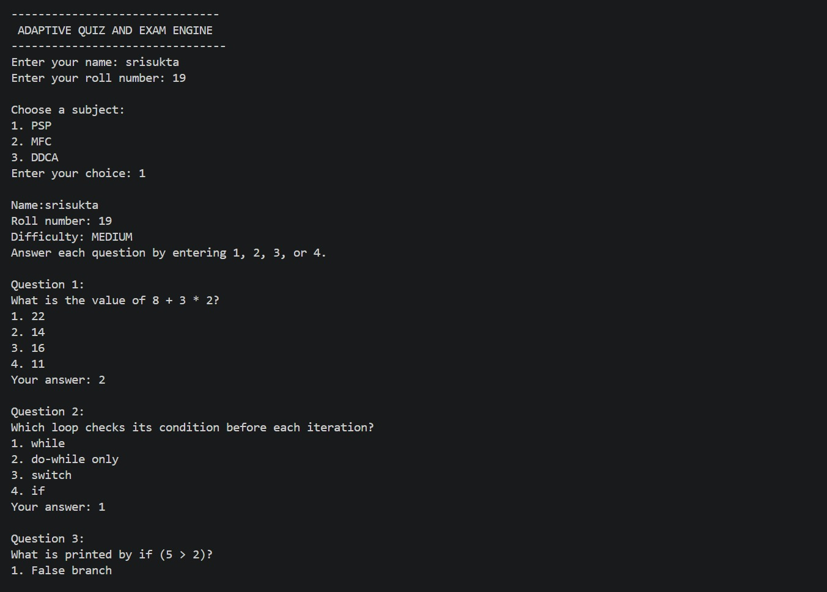
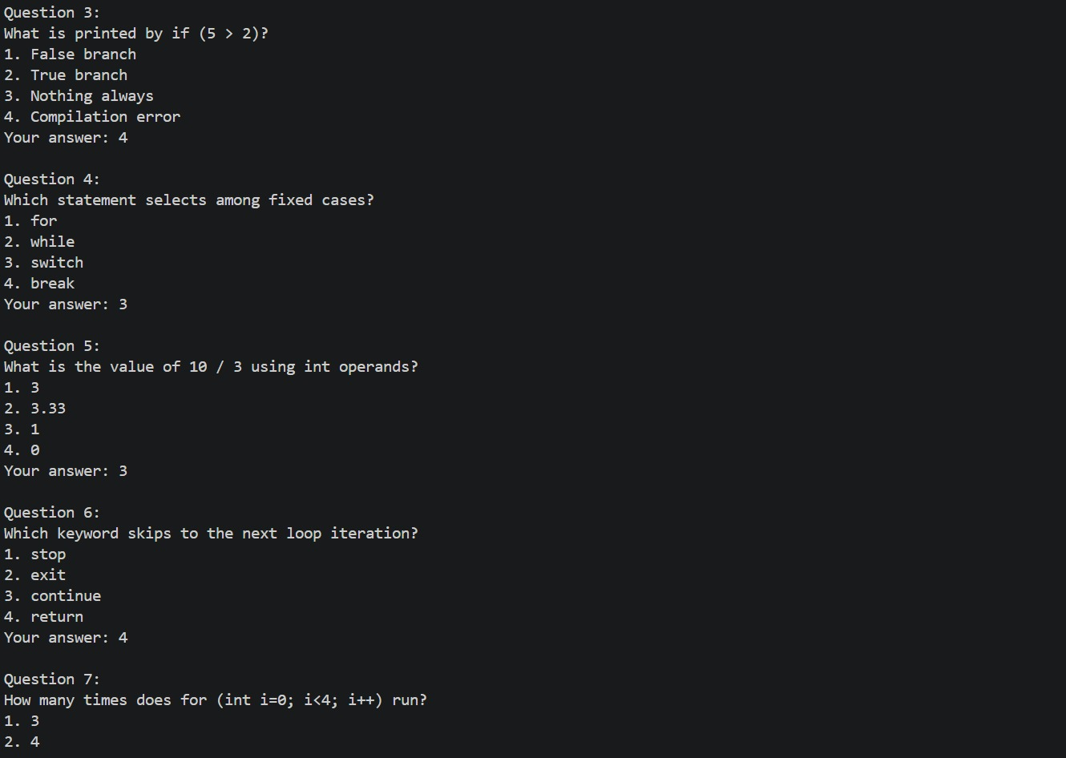
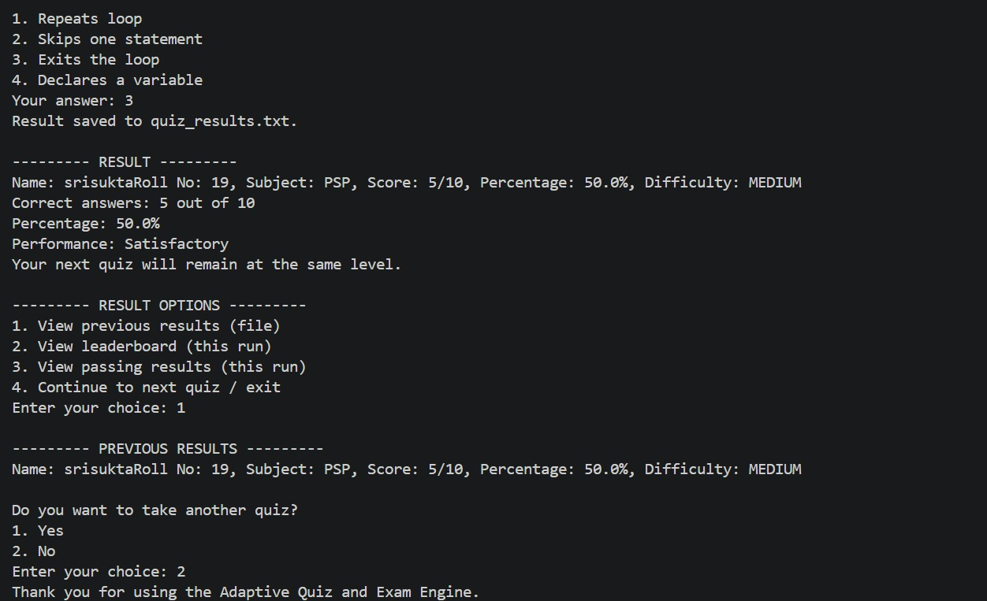
Output
1
2
Program run
1
Name, roll number, subject and Questions 1-3
2
Questions 3-7
3
4
3
Questions 3-7
4
Result, saved file and options

Slide 11

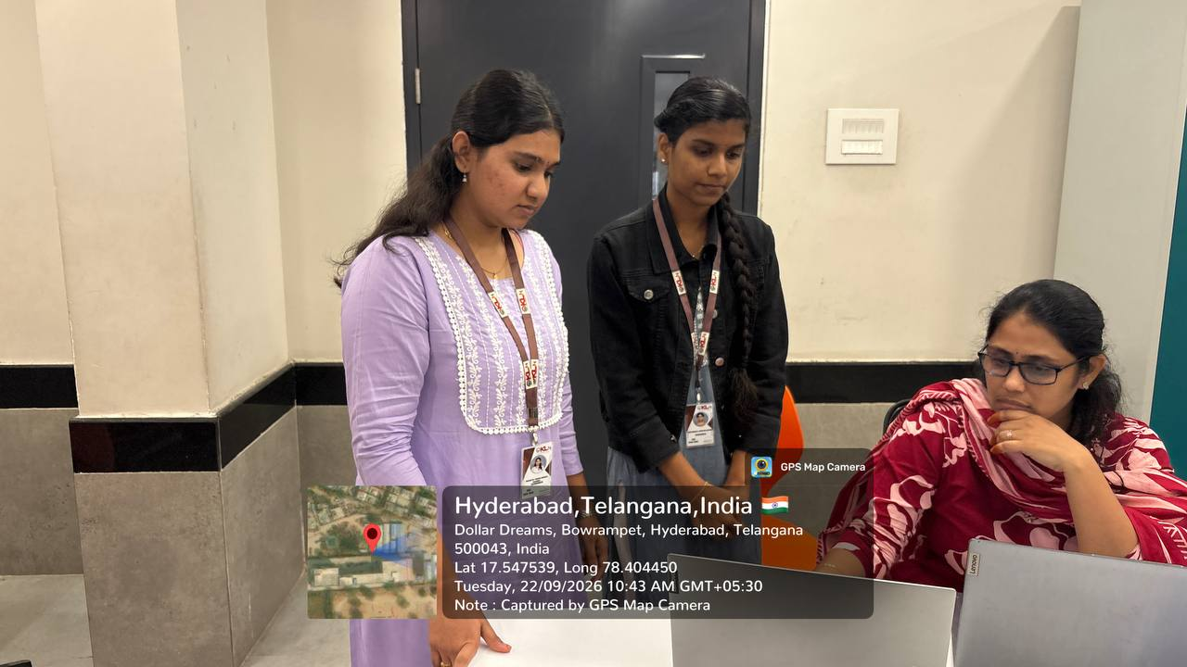

Geo Tag Photo and GitHub Link
GitHub Link
https://github.com/Akshitha1249

